Slide 1
Breaking down the coffee bean
Ashish Sharma

Slide 2
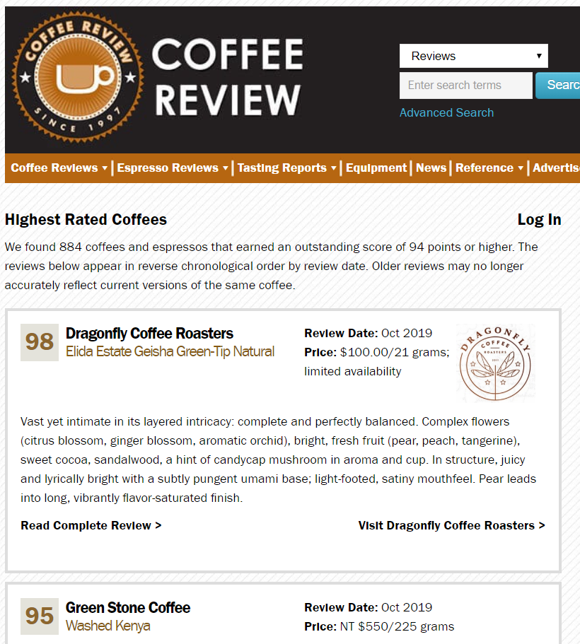
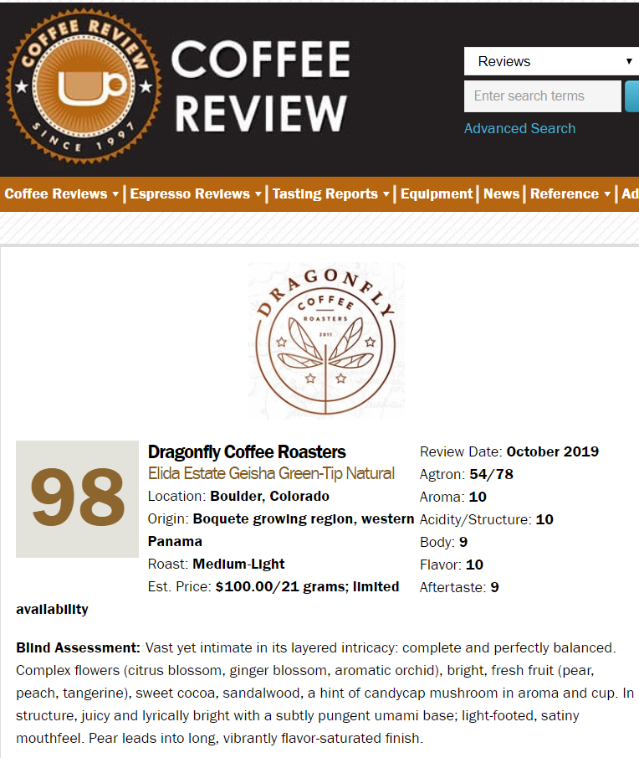
Scrapy: coffeereview.com
Source: coffeereview.com

Slide 3
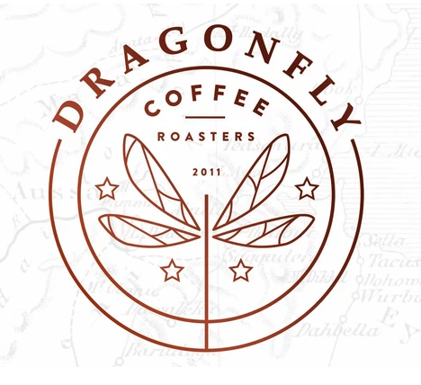

CoffeeReview at a glance
6
828
$217
Roast types across 3,614 coffee products
Cost of 12 oz of ground coffee beans by Dragonfly from CO
Roasters with ~485 of them in the US
31
98
Countries representing 111 regions
Highest review score of all coffees

Slide 4
Coffee Characteristics
Aroma
fragrance produced by hot, freshly brewed coffee
Acidity
Flavor
the pleasant tartness of a fine coffee
what distinguishes the sensory experience of coffee once its acidity, body, and aroma have been described
Aftertaste
Body
largely the product of all the other sensory elements you find in each sip. When you swallow, all these elements mingle to form the aftertaste
the sensation of heaviness, richness, or thickness and associated texture when one tastes coffee

Slide 5
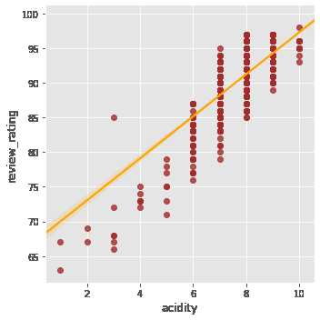
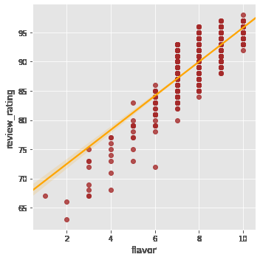
Review Rating and Coffee Characteristics
Aroma
0.784
Acidity
Flavor
0.802
0.805
Body
Aftertaste
0.634
0.738

Slide 6
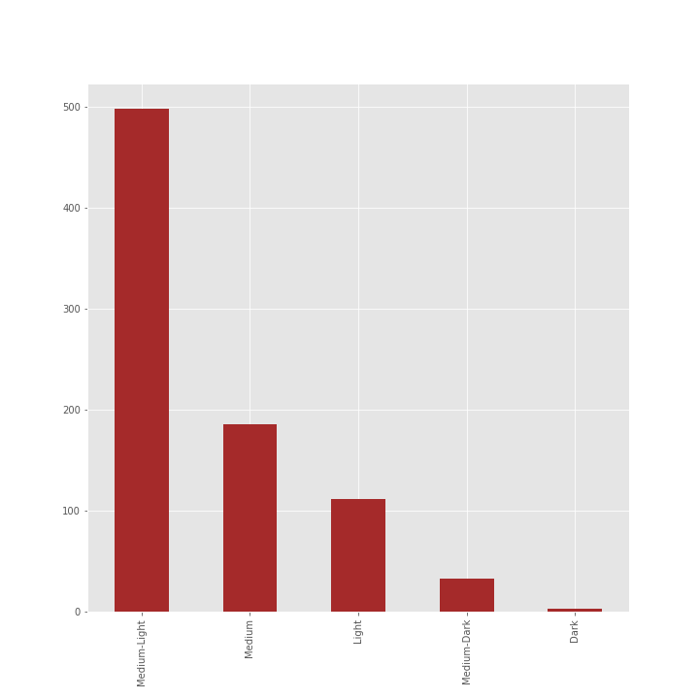
Roast Concentration
of top-rated coffees
60%
Medium-Light
22%
Medium
13%
Light
4%
Medium-Dark
1%
Dark

Slide 7
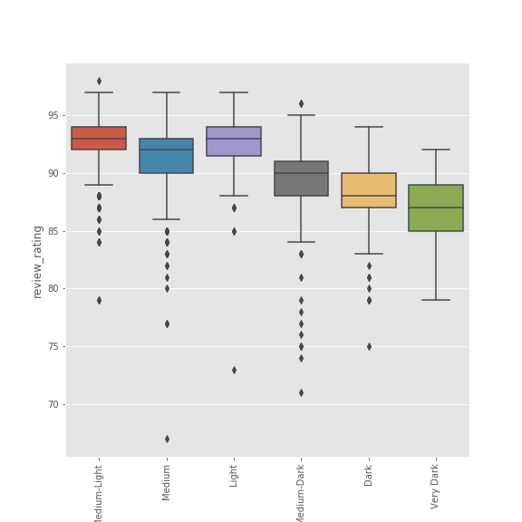

Ratings across coffee roast types

Slide 8
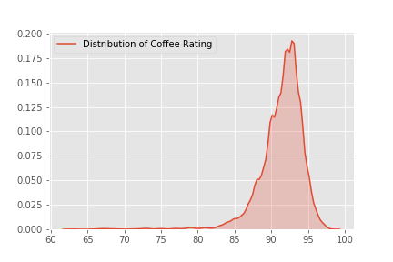
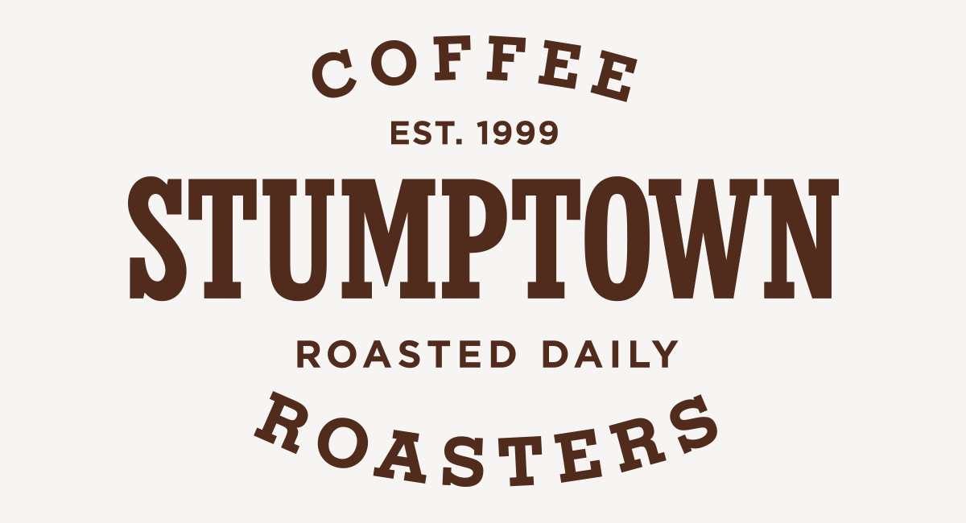
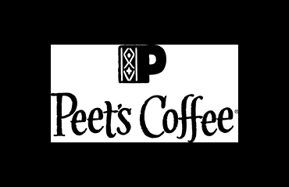



Review Score Concentration
Highly rated coffees have a review rating >= 94
Some of our household brands on the review spectrum

Slide 9
Next Steps
What makes up acidity? Analysis of its components and identification of biggest drivers.
Investigate how coffee contributes to flavor. Interesting to see how perception data can be collected and analyzed…
Incorporate location data to investigate bean characteristics that are determined by environmental conditions

Slide 10
What’s your cup of tea?

Slide 11
Appendix

Slide 12
Top 20 roasters
Review Rating | Product | Roaster | Origin | Location
98 | Elida Estate Geisha Green-Tip Natural | Dragonfly Coffee Roasters | Boquete growing region, western Panama | Boulder, Colorado
97 | 100% Kona SL-28 | Hula Daddy Kona Coffee | Holualoa, North Kona growing district, “Big Is... | Holualoa, Hawaii
97 | Panama Esmeralda Especial | PT's Coffee Roasting Co. | Boquete growing region, western Panama | Topeka, Kansas
97 | Kenya Mamuto | Terroir Coffee | South-central Kenya. | Acton, Massachusetts
97 | Esmeralda Especial Best of Panama | The Roasterie | Boquete growing region, western Panama | Kansas City, Missouri
97 | Kenya AA Wagamuga Auction Lot | Paradise Roasters | South-central Kenya. | Ramsey, Minnesota
97 | Ethiopia Biloya Special | Paradise Roasters | Southern Ethiopia | Ramsey, Minnesota
97 | Ethiopia Washed Yirgacheffe, Koke Grade 1 | Simon Hsieh's Aroma Roast Coffees | Yirgacheffe growing region, Sidamo Province, s... | Taoyuan City, Taiwan
97 | “Kona Sweet” 100% Kona | Hula Daddy | Holualoa, Hawaii | Holualoa, Hawaii
97 | Guatemala Hunapu Antigua Bourbon | Temple Coffee and Tea | Antigua valley, central Guatemala | Sacramento, California
97 | Kenya Nyeri AB Gichatha-ini Signature Series | Wood-Fire Roasted Coffee | Nyeri, Kenya. | Reno, Nevada
97 | Perci Red Panama Gesha | Barrington Coffee Roasting Co. | Silla Del Pando, Volcan, Panama. | Lee, Massachusetts
97 | Roastmaster’s Reserve Esmeralda | Caribou Coffee | Boquete growing region, western Panama | Minneapolis, Minnesota
97 | El Vergel Guatemala | Terroir Coffee | Patzun growing region, Guatemala. | Acton, Massachusetts
97 | Panama Ironman Camilina Geisha | Klatch Coffee | Boquete growing region, western Panama. | Los Angeles, California
97 | Panama La Esmeralda Geisha Bosque Natural | Temple Coffee and Tea | Boquete growing region, western Panama | Sacramento, California
97 | Finca La Mula Panama Geisha | JBC Coffee Roasters | Chiriqui, western Panama. | Madison, Wisconsin
97 | Kenya Guama Peaberry | Bird Rock Coffee Roasters | South-central Kenya | San Diego, California
97 | Ninety Plus Gesha Estates Limited Batch #227 | JBC Coffee Roasters | Chiriqui Province, far western Panama | Madison, Wisconsin
97 | Yemen Port of Mokha Hayma Microlot | Dragonfly Coffee Roasters | Hayma, north-central Yemen | Boulder, Colorado

